Slide 1


Machine Learning Report
SWE6204 Project Presentation
HE23547

Slide 2
Types of Machine Learning and Use Cases
- Supervised Learning: Stock Price Prediction, Social Media Content Detection
- Unsupervised Learning: Patient Segmentation
- Reinforcement Learning: Autonomous Drone Delivery

Slide 3
K-Means vs K-Nearest Neighbors (KNN)
K-Means: Unsupervised, clustering unlabeled data
KNN: Supervised, classification using nearest neighbors
Key Difference: Labels required in KNN but not in K-Means

Slide 4
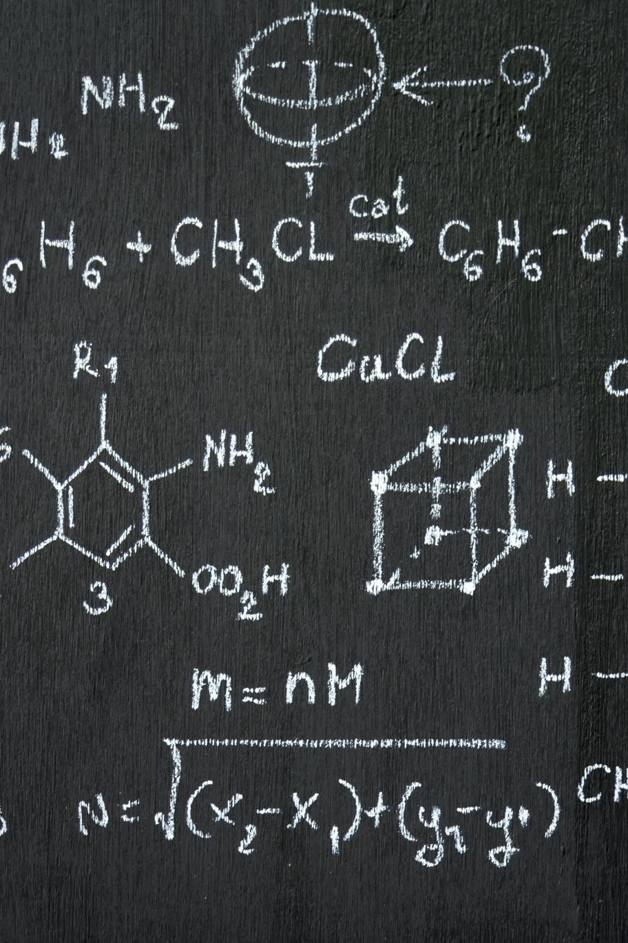
Loss Function in Linear Regression
Loss function measures error between predictions and true values.
Mean Squared Error (MSE) is commonly used:
MSE = (1/n) Σ (yi - ŷi)²

Slide 5
Overfitting in Machine Learning
Overfitting: Model learns noise instead of patterns.
Symptoms: High training accuracy, low test accuracy.
Prevention: Regularization, Cross-validation, Early Stopping.

Slide 6
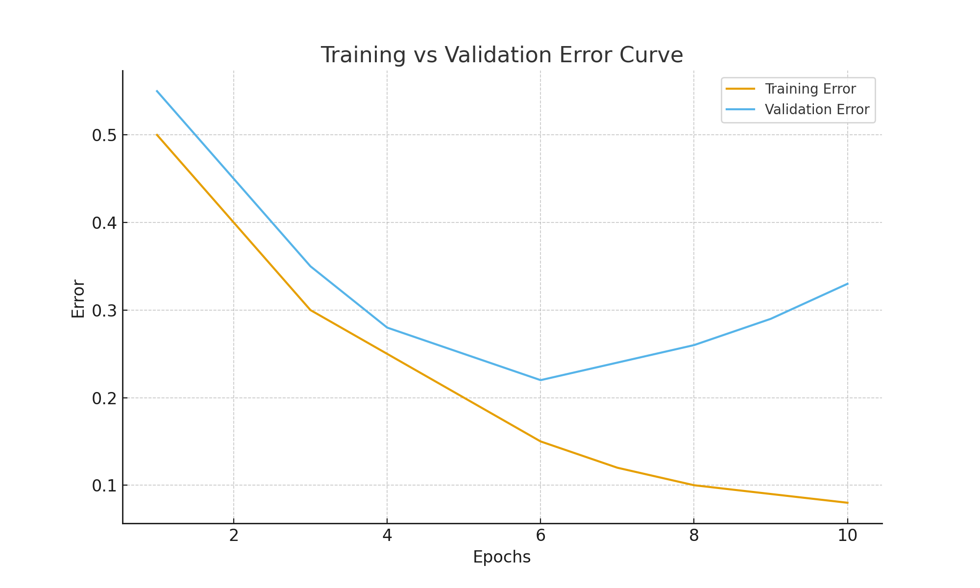
Training vs Validation Error Curve

Slide 7
Data Exploration: Housing Dataset
- Histograms: House Size, Bedrooms, Price
- Bar Chart: Locations
- Scatter Plot: Size vs Price

Slide 8
Random Forest Regression Performance
Before Tuning:
- R² = 0.915
- RMSE = 23,603
After GridSearchCV Tuning:
- R² = 0.930
- RMSE = 21,900

